Slide 1
Data Mining
Association
&
Classification [Decision Tree]

Slide 2
Data Mining
Data Mining (DM) is a knowledge discovery process of automated extraction of hidden predictive information from large databases.
DM is a powerful new technology with huge potential to help organizations focus on the most important information in their data warehouses.
DM tools sift through large amounts of data to discover meaningful new correlations and hidden patterns.
DM tools predict future trends and behaviors, allowing businesses to make proactive, knowledge-driven decisions.
DM is a process or methodology, not a single analytical technique or tool.

Slide 3
Objects and Benefits
Knowledge discovery process
Automated prediction of trends and behaviors
Automated discovery of previously unknown patterns
Results used to make better business decisions and to gain a competitive advantage
Find hidden predictive information

Slide 4
Common Data Mining Techniques
Association
Classification
Sequential patterns
Patterns with time series
Categorization and segmentation

Slide 5
Association
Find all the association rules with support and confidence higher than specified values.
Association rules discover regular patterns within large data sets, such as the presence of two items within a group of tuples.
Rules discover situations in which the presence of an item in a transaction is linked to the presence of another item with a high probability.
An association rule consists of a premise and a consequence. Both premise and consequence can be single items or groups of items.
Quality of association rules can be measured precisely, by defining the properties of support and confidence.

Slide 6
Example of Association
Possible Set:
{Chicken Fries, Drinks} -> 3
{Burger, French Fries} -> 3
{Pizza, Drinks} -> 2
{Chicken Fries, Drinks, French Fries} -> 1
{Chicken Fries, French Fries, Burger} ->1
{Burgers, Drinks, French Fries} -> 1
{Chicken Fries, Pizza, Drinks} -> 1
Max Data set :
{Chicken Fries, Drinks}
{Burger, French Fries}
So we can predict that if any one buy Chicken Fries then he will buy Drinks. Or that if any one buy Burger then he will buy French Fries.
SLNo. | ITEMS
1 | Chicken Fries, Drinks
2 | Burger, French Fries
3 | Pizza, Drinks
4 | Chicken Fries, Drinks, French Fries
5 | Chicken Fries, French Fries, Burger
6 | Burgers, Drinks, French Fries
7 | Chicken Fries, Pizza, Drinks

Slide 7
Classify a phenomenon in a predefined class
The phenomenon is usually presented in the form of an observation record(tuple).
The classifier is an algorithm that carries out the classification, and the classifiers are typically presented as decision trees. In these trees the nodes are labelled by conditions that allow the decision making.
There are two typical methods of classification:
Decision trees
Neural networks

Slide 8
Decision trees
A decision tree is a structure that includes a root node, branches, and leaf nodes. Each internal node denotes a test on an attribute, each branch denotes the outcome of a test, and each leaf node holds a class label. The topmost node in the tree is the root node.
The benefits of having a decision tree are as follows −
It does not require any domain knowledge.
It is easy to comprehend.
The learning and classification steps of a decision tree are simple and fast.

Slide 9
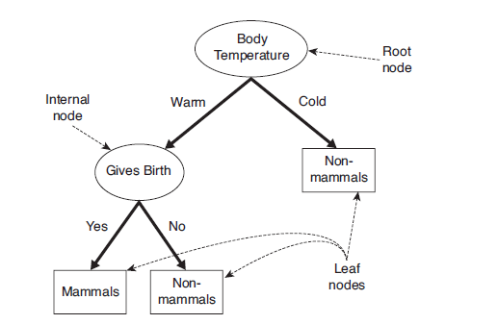
Structure of Decision Tree

Slide 10
Decision Tree Algorithm
There are many Decision Tree Algorithm. Like as..
Hunt’s Algorithm [for Binary Splitting]
Tertiary Tree [Multiway Splitting]
CART
ID3, C4.5
SLIQ,SPRINT

Slide 11
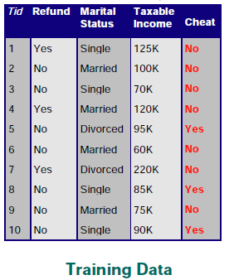
Hunt’s Algorithm [for Binary Splitting]
Refund | Marital Status | Taxable Income | Cheat
No | Married | 80K | ?
No | Single | 60K | ?
No | Divorced | 120K | ?
Test Set

Slide 12
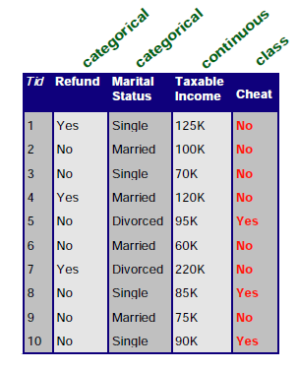
Attributes of Training Set

Slide 13
Create Decision tree for Training Set
Refund
Yes
No
No
Marital Status
{Single, Divorced }
Married
Taxable Income
No
<= 80 K
> 80 K
No
Yes

Slide 14
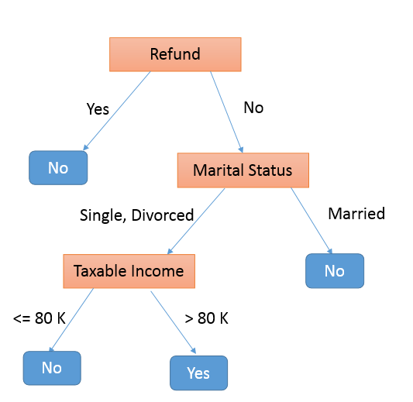
Implement Test Set on this Tree
Refund | Marital Status | Taxable Income | Cheat
No | Married | 80K | ?
No | Single | 60K | ?
No | Divorced | 120K | ?
Refund | Marital Status | Taxable Income | Cheat
No | Married | 80K
No | Single | 60K
No | Divorced | 120K
No
No
Yes

Slide 15
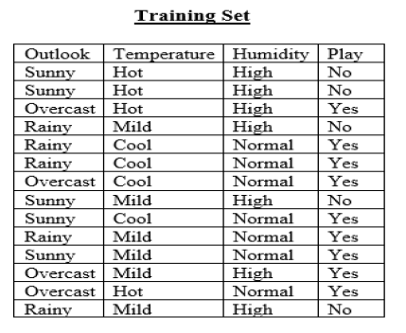
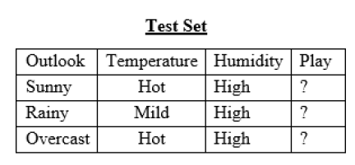
Tertiary Tree [Multiway Splitting]

Slide 16
Create Decision tree for Training Set
Outlook
Overcast
{Sunny, Rainy}
Play
Temperature
Mild
Cool
Hot
Humidity
Play
Don’t Play
High
Normal
Don’t Play
Play

Slide 17
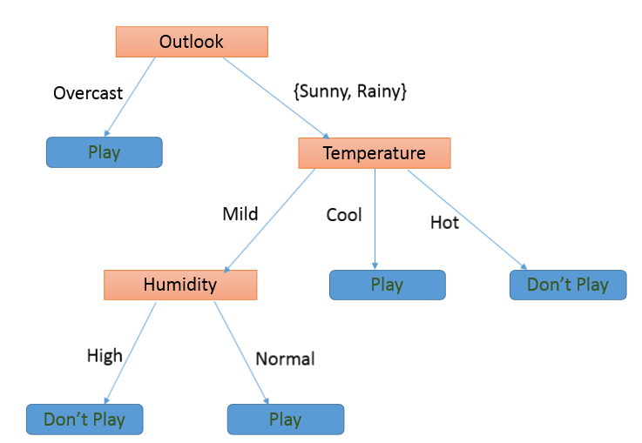
Implement Test Set on this Tree
Outlook | Temperature | Humidity | Play
Sunny | Hot | High | Don’t Play
Rainy | Mild | High | Don’t Play
Overcast | Hot | High | Play

Slide 18
Any Questions?
Thank You.....

